Slide 1
ADVANCED ELECTRONICS
UNIT 5: INTERFACING DEVICES
DONE BY:
T.RATHNA
DEPARTMENT OF PHYSICS
GCWK

Slide 3
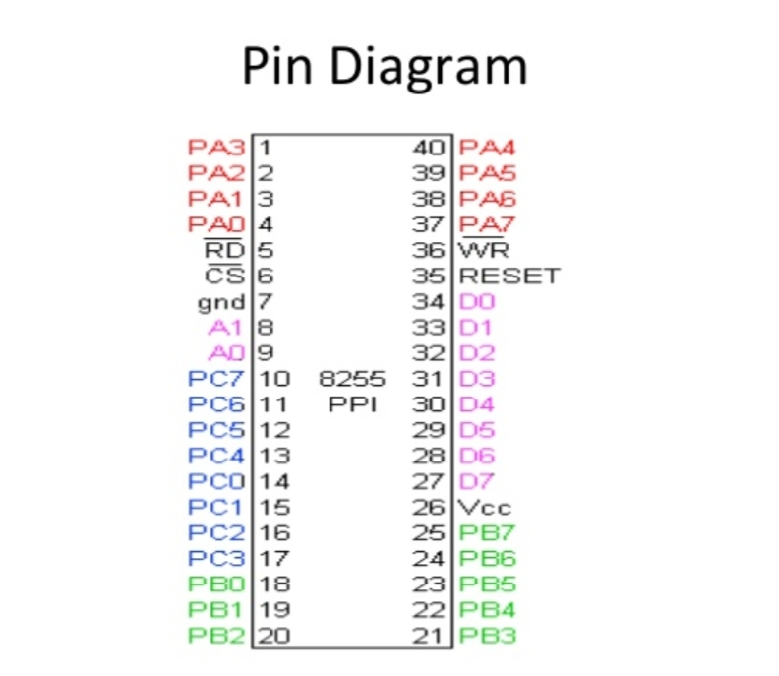

Slide 5
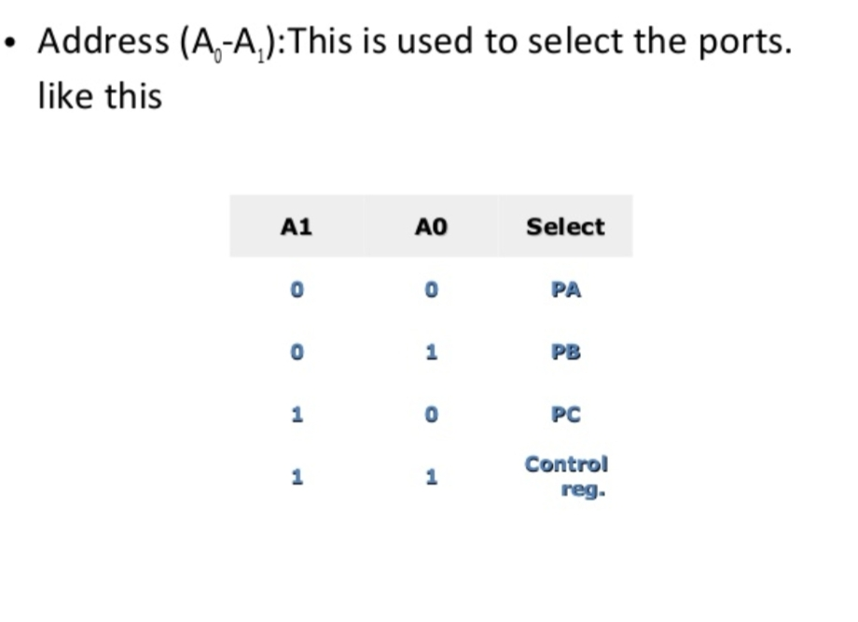

Slide 7
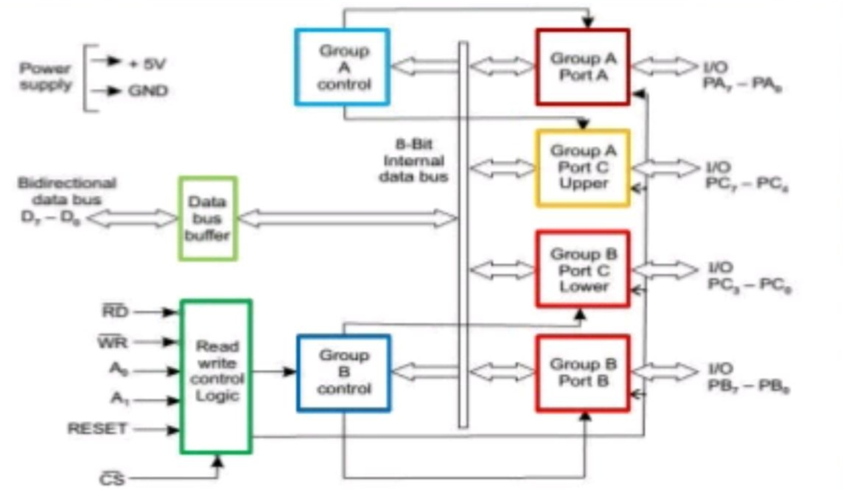
BLOCK DIAGRAM OF 8255:

Slide 19
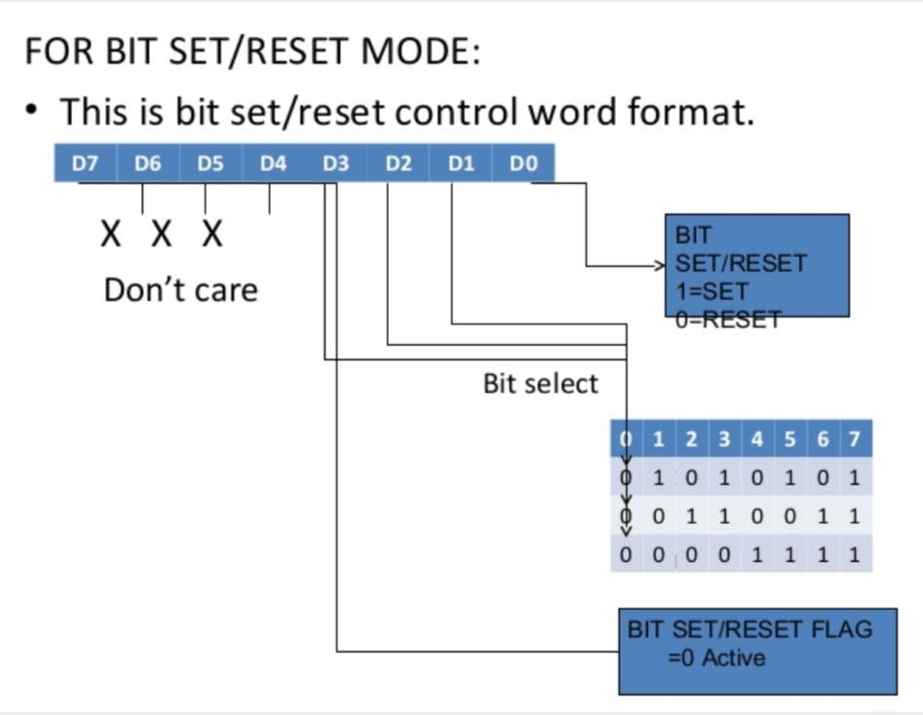

Slide 21
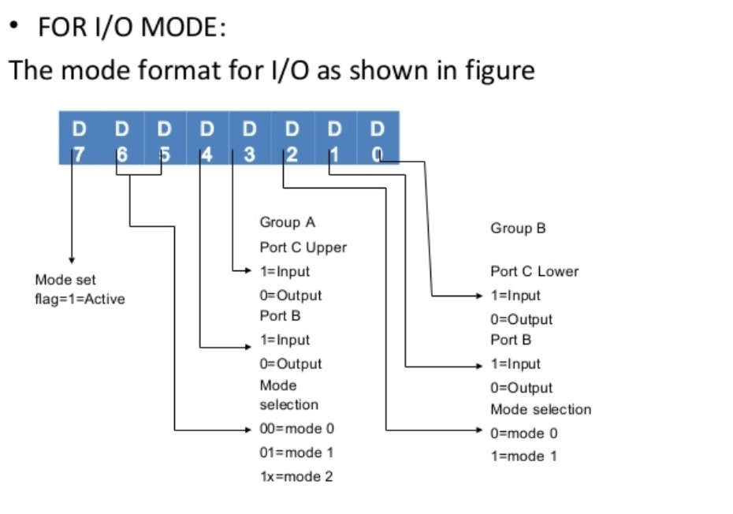

Slide 22
