Slide 1
NQR SPECTROSCOPY
Name of the instructor:U.Nithya M.Sc.,M.Phil.,

Slide 19
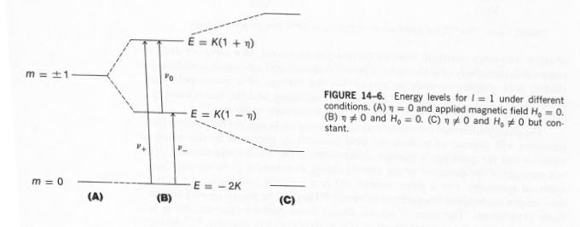
Effect of a magnetic field on the spectra:

Slide 20
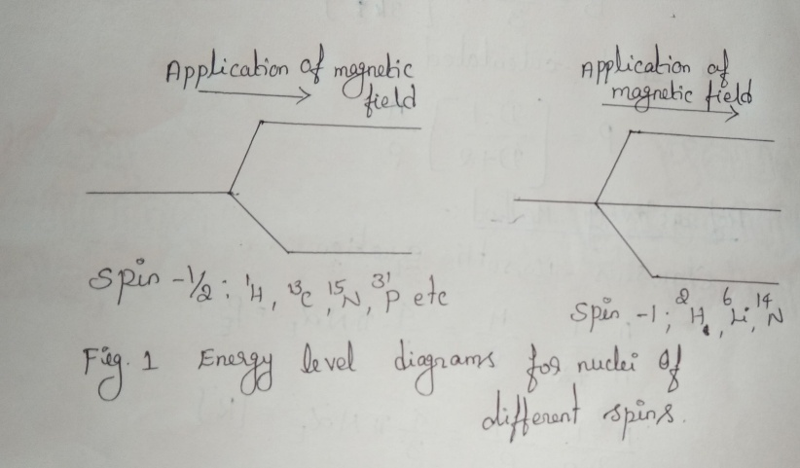
Energy levels of NQR spectroscopy: Their energies spilt upon the application of a magnetic field into multiple levels. By comparison spin -1/2 nuclei split into only two levels.The number of levels is given by 2n+1 where is the spin number. The different splitting patterns can be seen in their coupling with other nuclei.
NQR transitions:
The NQR resonance is mediated by the interaction of the electric field gradient (EFG) with the quadrupole moment of the nuclear charge distribution. It is this product which is termed the nuclear quadrupole coupling constant for a given isotope in a material and can be found in tables of known NQR transitions.

Slide 29
THANK YOU

