Slide 1
INDUSTRIAL MICROBIOLOGY
FERMENTATION
BIOCHEMISTRY OF FERMENTATION
FERMENTATION PRODUCTS

Slide 27
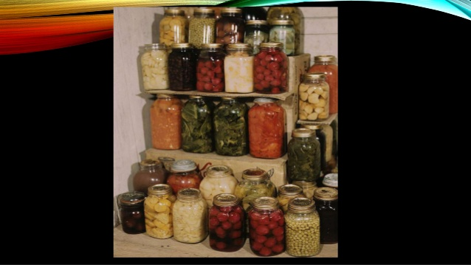

Slide 32
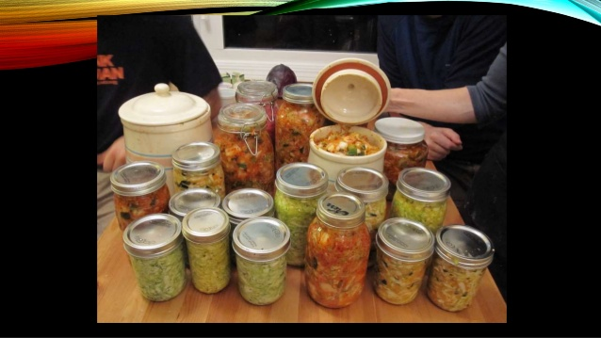

Slide 33
THANK YOU

