Slide 1
MENTHOL
INTRODUCTION
SYNTHESIS
STRUCTURE
APPLICATION

Slide 2
INTRODUCTION
MENTHOL
Menthol is an organic compound made synthetically or obtained from the oils of cornmint, Peppermint, or other mints.
It is a waxy, crystalline substance, clear or white in color, which is solid at room temperature and melts slightly above.

Slide 3
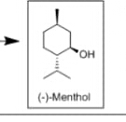
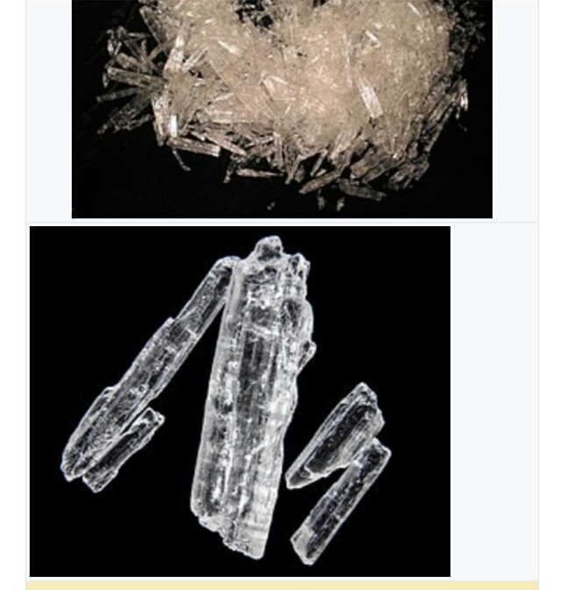
MENTHOL
STRUCTURE OF MENTHOL

Slide 4
BIO SYNTHESIS OF MENTHOL
The Biosynthesis of menthol has been investigated in mentha x piperita and the enzymes involved.
It begins with the synthesis of the terpene limonene, followed by hydroxylation, and then several reduction and isomerization steps.
The Biosynthesis of (-)- menthol takes place in the secretory gland cells of the peppermint plant.
Geranyl diphosphate synthesis (GPPS), first catalyzes the reaction of IPP and DMAPP into geranyl diphosphate.

Slide 5
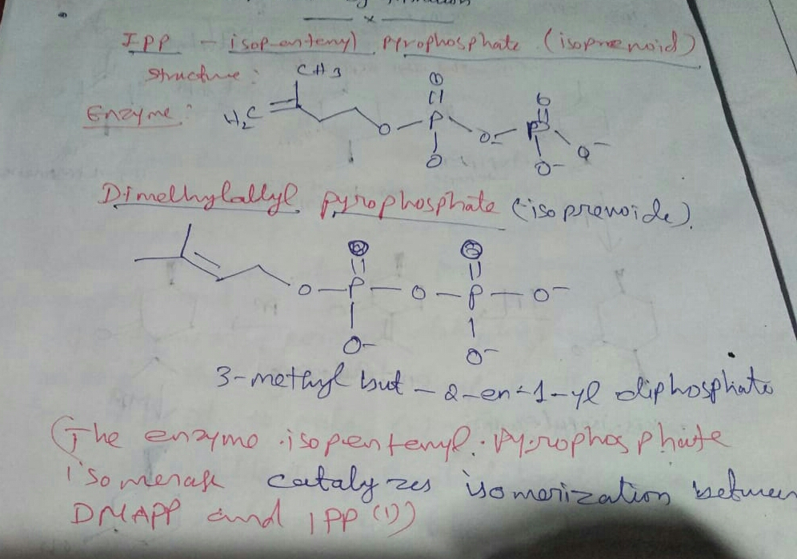
IPP AND DMAPP STRUCTURE:

Slide 6
Next (-)-limonene synthase (LS) catalyzes the cyclization of geranyl diphosphate to (-)- limonene.
(-)- Limonene -3-hydroxylase (L30H), using O2 and NADPH, then catalyzes the allylic hydroxylation of (-)- limonene at the 3 position to (-)-trans-isopiperitenol.
(-)-trans-isopiperitenol dehydrogenase(IPD) further oxidizes the hydroxyl group on the 3 position using NAD+ to make (-)-isopiperitenone.

Slide 7
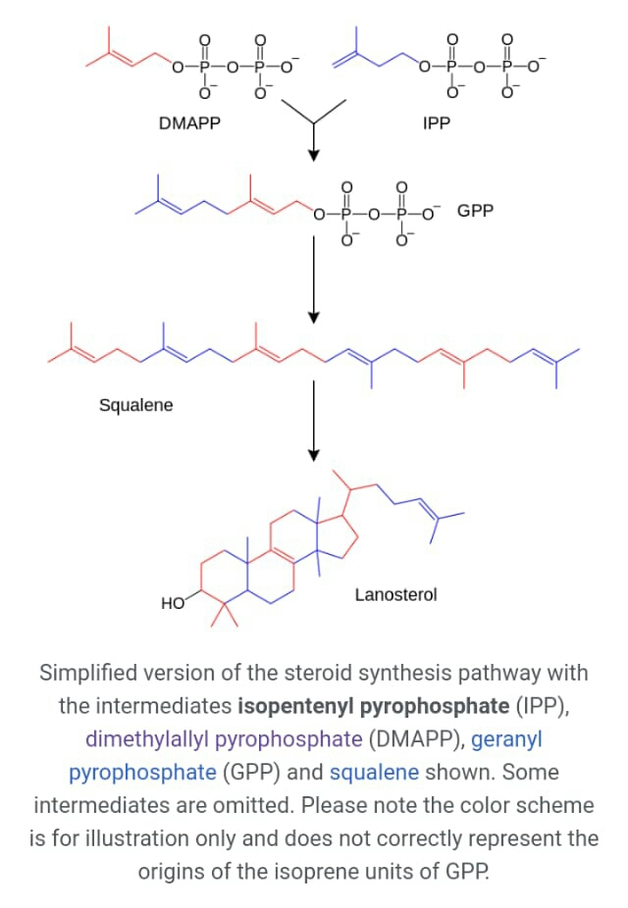

Slide 8
(-) –isopiperitenone reductase (IPR) the n reduces the double bond between carbons 1 and 2 using NADPH to form (+)–cis-isopulegone.
(+)-Cis-isopulegone isomerase (IPI) then isomerizes the remaining double bond to form (+) -pulegone.
(+)-pulegone reductase (PR) then reduces this double bond using NADPH to form (-)-menthone.
(-)–menthone reductase (MR) then reduces the carbonyl group using NADPH to form (-) –Menthol[10].

Slide 9
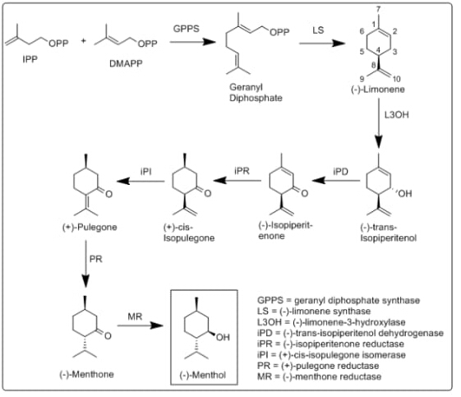

Slide 10
GPPS = geranyl diphosphate synthase
LS = (-)-limonene synthase
L3O = (-)-limonene-3-hydroxylase
IPD = (-)-trans-isopieritenol dehydrogenase
IPR = (-)-isopiperitenone reductase
IPL = (+)-Cis-isopulegone isomerase
PR = (+)-pulegone reductase
MR = (-)-menthone reductase
Natural menthol is obtained by freezing peppermint oil. The resultant crystals of menthol are then separated by filtration.

Slide 11
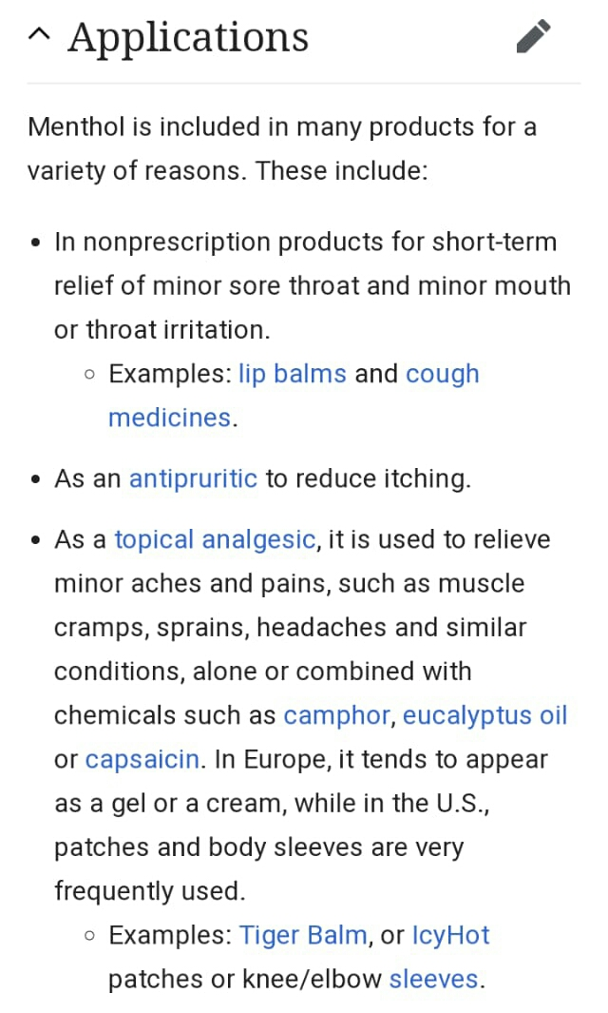

Slide 12
THANKYOU

