Slide 1
Unit – II – Memory Management

Slide 2
Memory Management (MM)
Concerned with management of primary memory
Four functions of Memory management
Keeping track of the status of each location of primary memory, i.e., each location is either allocated or unallocated
Determining allocation policy for memory, i.e., deciding to whom it should go, how much, when, and where.
Allocation technique – once it is decided to allocate memory, the specific locations must be selected and allocation information updated.
Deallocation technique and policy – handling the reclaiming of memory.

Slide 3
Different Techniques of MM
Single Contiguous MM
Partitioned MM
Relocation partitioned MM
Paged MM
Demand Paged MM
Segmented MM
Segmented and Demand paged MM
Other MM Schemes

Slide 4
Four sections of MM techniques
An overview of the approach and concepts employed
A description of any special hardware facilities required or recommended.
A description of the particular software algorithms and processing required
A discussion of the advantages and disadvantages of the particular strategy

Slide 5
Single Contiguous MM
Small stand-alone computer with simple batch OS
No multiprogramming
One-to-one correspondence exists between a user, a job, a job step and a process.
Only one job will be used
Memory is allocated to the job

Slide 6
Single Contiguous MM…
OS
User area
Free Area
Single Contiguous allocation in a memory

Slide 7
Single Contiguous MM…
Functions
Keeping track of memory – it is allocated entirely to one job
Determining factor on memory policy – the job gets all memory when scheduled.
Allocation of memory - all of it is allocated to the job.
Deallocation of memory – when the job is done, all memory is returned to free status.

Slide 8
Single Contiguous MM…
Hardware Support –
No special hardware is required for contiguous allocation.
Sometimes primitive hardware protection mechanism is desirable to ensure that the user’s program do not accidentally or maliciously tamper with the OS.
It consists of bounds register – contains the address of the protected area.

Slide 9
Single Contiguous MM…
Software Support -
Enter
Is required job size <= available memory
No
Job cannot be run – error condition, try another job
Yes
Assign Memory to job Load and execute Job
Job finished deallocate memory and find another job to run

Slide 10
Single Contiguous MM…
Advantages –
Simplicity
It does not require great expertise to understand the system.
Disadvantages –
Memory is not fully utilized
Poor utilization of Memory, CPU and I/O channel and I/O devices.
Lack of flexibility
User’s job size is limited to the size of available memory.

Slide 11
Introduction to multiprogramming
Keeping more than one job at a time on memory – distribute the resources among these jobs – multiprogramming, is a interleaved or concurrent execution of two or more processes.
Examples of Multiprogramming :
Job1(30K) – Compute C1 – I/O I1
Job2(50K) – Compute C2 – I/O I2
Job3(20K) – Compute C3 – I/O I3

Slide 12
Introduction to multiprogramming…
I1<=C2+C3
Processor waiting time : I1-(C2+C3)
The processor utilization is higher in multiprogramming
Measures of System I/O Wait percentage-
The computation and I/O are intermingled in complex ways.
A useful aggregate parameter is the job’s percentage of I/O wait time, ω,which equals
Total I/O wait time
total I/O plus total CPU time

Slide 13
Introduction to multiprogramming…
If we have two jobs each with ω=50%, and they are multiprogrammed is the effective system I/O wait percentage ω’, reduced to zero?
If C1=I1=C2=I2, then C2 will be executed concurrently with I1

Slide 14
Introduction to multiprogramming…

Slide 15
Introduction to multiprogramming…
If we have n processes, each with same I/O wait percentage ,ω, the system I/O wait percentage ω’ is approximately by ω’= ω^{n}.
For example if ω=50% then
No. of Processes N | System I/O wait percentage
1 | (.50)¹=50%
2 | (.50)²=25%
3 | (.50)³=12.5%
4 | (.50)⁴=6.3%
5 | (.50)⁵=3.1%
6 | (.50)⁶=1.6%

Slide 16
Introduction to multiprogramming…
System I/O wait percentage is

Slide 17
Partitioned Allocation
Main memory is divided into number of memory regions or memory partitions
Each partition holds a separate job’s address space is shown in the following figure

Slide 18
Partitioned Allocation…

Slide 19
Partitioned Allocation…
Function of partition MM
Keeping track of the status of each partition (eg. “in use” or “not in use”,size)
Determining who gets memory – this is handled largely by the job scheduler.
Allocation – an available partition of sufficient size is assigned
Deallocation – when the job terminates, the partition is indicated “not in use” and is available for future allocation.

Slide 20
Partitioned Allocation…
Hardware Support-
Little special hardware is needed
Two bounds register to bracket the partition being used Disadantage : 1. the bounds registers must be changed every time that the processor is reassigned for multiprogramming, 2. it is difficult to extend this protection to the I/O channel, In multiplexor channels required more bounds register
In IBM 370 used protection key with each block of memory (1 through 15) key 0 for OS

Slide 21
Partitioned Allocation…
Software Algorithm
Static Partition specification
Dynamic Partition specification

Slide 22
Operating Systems – 7

Slide 23
Partitioned Allocation
Main memory is divided into number of memory regions or memory partitions
Each partition holds a separate job’s address space is shown in the following figure

Slide 24
Partitioned Allocation…

Slide 25
Partitioned Allocation…
Function of partition MM
Keeping track of the status of each partition (eg. “in use” or “not in use”,size)
Determining who gets memory – this is handled largely by the job scheduler.
Allocation – an available partition of sufficient size is assigned
Deallocation – when the job terminates, the partition is indicated “not in use” and is available for future allocation.

Slide 26
Partitioned Allocation…
Hardware Support-
Little special hardware is needed
Two bounds register to bracket the partition being used Disadantage : 1. the bounds registers must be changed every time that the processor is reassigned for multiprogramming, 2. it is difficult to extend this protection to the I/O channel, In multiplexor channels required more bounds register
In IBM 370 used protection key with each block of memory (1 through 15) key 0 for OS

Slide 27
Partitioned Allocation…
Software Algorithm
Static Partition specification
Dynamic Partition specification
Static Partition Specification : Memory is divided into partition prior to the processing of any jobs. The partition specification may be designated by the computer operator or it may be built into the OS.

Slide 28
Partitioned Allocation…
Static partition specification table
Partition number | Size | Location | Status
1 | 8K | 312K | IN USE
2 | 32K | 320K | IN USE
3 | 32K | 352K | NOT IN USE
4 | 120K | 384K | NOT IN USE
5 | 520K | 504K | IN USE

Slide 29
Partitioned Allocation…
When size and frequency of jobs are well known. The partition sizes are chosen to correspond closely to the most common job sizes.
Partition number | Size | Job Size | Wasted Space
1 | 8K | 1K | 7K
2 | 32K | 9K | 23K
3 | 32K | 9K | 23K
4 | 120K | 33K | 87K
5 | 520K | 121K | 399K
Total | 712K | 173K | 539K

Slide 30
Partitioned Allocation…
Dynamic Partition Specification:
Partitions are created during job processing so as to match partition sizes to job sizes. The technique have been called partitioned memory, dynamic storage allocation, controlled storage and garbage collection.
Two tables required to do dynamic partition
Allocated Partition Status table
Unallocated Area Status table

Slide 31
Partitioned Allocation…
Allocated Partition Status Table
Partition Number | Size | Location | Status
1 | 8K | 312K | ALLOCATED
2 | 32K | 320K | ALLOCATED
3 | - | - | EMPTY ENTRY
4 | 120K | 384K | ALLOCATED
5 | - | - | EMPTY ENTRY

Slide 32
Partitioned Allocation…
Unallocated Area Status table
Free Area | Size | Location | Status
1 | 32K | 352K | AVAILABLE
2 | 520K | 504K | AVAILABLE
3 | - | - | EMPTY ENTRY
4 | - | - | EMPTY ENTRY
- | - | - | -

Slide 33
Partitioned Allocation…

Slide 34
Partitioned Allocation…

Slide 35
Partitioned Allocation…
Two partition allocation schemes
First fit
Best fit
First Fit Partition Algorithm : In this the free table is kept sorted by location, we start at the free area at the lowest memory address and keep looking until we find the first free area big enough for the partition to fit.
2 major advantages, 1. Is partition adjacent to any free area? in the deallocation algorithm usually searching half the table, here lower memory location so always found first. 2. it favours using the free areas at low memory address
When a very large partition size is needed, there is a good chance of finding a large enough free area.

Slide 36
Partitioned Allocation…
Best fit partition algorithm
The free table is kept sorted by size ( i.e., the first entry corresponds to the free area with smaller size)
The first free area we find that is large enough for the desired partition is best fit.
3 advantages – 1. on the average the best fit area can be found by searching only half the table.
2. If there is a free area of exactly the desired size, it will be selected,
3. If there is no free area of exactly the desired size, the partition is carved out of the smallest possible free area and does not destroy a large free area.

Slide 37
Partitioned Allocation…
Disadvantage is that the free area is not exactly right size and must be split it into two pieces, due to the best fit criteria, the resulting free area is often quite small – so small that it may be almost worthless

Slide 38
Partitioned Allocation…

Slide 39
Partitioned Allocation…
Fragmentation Problem: free memory area unable to utilize because of smaller in size scattered around the memory is called fragment. The development of a large number of separate free areas is fragmentation problem.
Fragmentation problem may be rectified to move the free areas together with other techniques.

Slide 40
Partitioned Allocation…
Multiple partition algorithm : this technique sometimes decrease the fragmentation problem. The Job require 100K of memory may actually consists of five 20K portions. The Job can be allocated either one 100K partition, or five 20K partitions or two 40K and one 20K partition and so on. This approach is called multiple partition allocation.

Slide 41
Partitioned Allocation…
Advantages- It facilitates multiprogramming, hence, more efficient utilization of the processor and I/O devices.
It requires no special costly hardware.
The algorithms used are simple and easy to implement.
Disadvantages : Fragmentation problem leads to under utilization of memory
Job size is limited to the memory size.
It does require more memory than a single contiguous allocation

Slide 42
Operating Systems - 8
Relocatable Partitioned Memory Management

Slide 43
Relocatable Partitioned Memory Management
The fragmentation problem is to periodically combine all free areas into one contiguous area.
This can be done by moving the contents of all allocated partitions so that they become contiguous.
This process is called compaction or recompaction or burping

Slide 44
Relocatable Partitioned Memory Management…

Slide 45
Relocatable Partitioned Memory Management…
Moving a job’s partition doesn’t quarantee that the job will still run correctly at its new location.
This is because there are many location sensitive items such as
1). Base registers,
2). Memory referencing instructions,
3). Parameter lists and
4). Data structures ( eg. Lists, chains, stacks, queues etc.) that use address pointers.
To operate correctly, all location sensitive items must be suitably modified. Eg. Job 4 moved from 352K to 320K, all address must be decreased by 32K.

Slide 46
Relocatable Partitioned Memory Management…
Another possible solution exists to the relocation problem could reload all jobs to be relocated and restart them from the beginning.
Several hardware techniques have been developed to cope with this relocation problem.
– concept of mapped memory: the address space “seen” by a job is not necessarily the same as the physical memory address used. This concept is sometimes called virtual memory.
Except for the process of compaction and relocation, this scheme is very similar to the partition allocation scheme.

Slide 47
Relocatable Partitioned Memory Management…
Hardware Support:
There are two common approaches to the relocation problem, both of which require special hardware support.
One approach based upon the data typing concept, physically records the type of value stored in every memory location.- 2bits to every word to designate the value type: 00-integer, 01-floating number, 10- Character, 11- address pointer. A=B, not only sets A to the value of B but also copies the type information. The extra bits in compaction may be slow because of the each word to be examined.
Another common hardware solution uses dynamic relocation by means of base-bounds relocation registers. Two special privileged registers, the base relocation register and the bounds register are accessible only by the operating system.
On every memory reference, the content of the base relocation register is automatically added to the effective address. The effective address is the final reference address computed by the processor.

Slide 48
Relocatable Partitioned Memory Management…

Slide 49
Relocatable Partitioned Memory Management…
The relocation adjustment is done automatically as each instruction is executed, it is called dynamic relocation.
Protection – locks and keys.
More commonly a bounds register is set to the maximum address in the job’s address space.

Slide 50
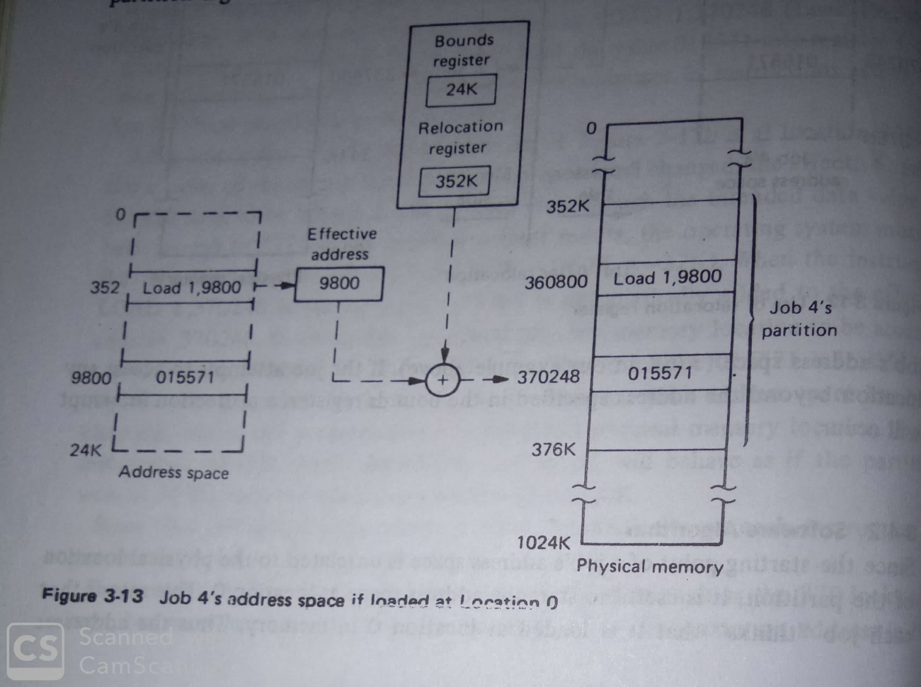
Relocatable Partitioned Memory Management…
Software Algorithm:

Slide 51
Relocatable Partitioned Memory Management…

Slide 52
Relocatable Partitioned Memory Management…
Advantages:
It eliminates fragmentation
High degree of multiprogramming
It results in increased memory, Processor and I/O devices utilization.

Slide 53
Relocatable Partitioned Memory Management…
Disadvantages:
Relocation hardware increases the cost of the computers and may slow down the speed.
Compaction time may be substantial.
Some memory will still be unused because even though it is compacted, the amount of free area may be less than the needed partition size.
Memory contain some information that is never used.
Job’s partition size is limited to the size of physical memory

Slide 54
Operating Systems-9
Paged Memory Management – Part I

Slide 55
Paged Memory Management
To avoid fragmentation problem in relocatable partitioned allocation approach is to allow the individual free areas to be combined into one contiguous free area.
This is for loading the entire Job address space into a contiguous area.
To avoid contiguity requirement is through paged memory management.

Slide 56
Paged Memory Management…
Job’s address space divided into equal pieces is called as pages.
Memory is divided into pieces of same size, called blocks.
By providing a suitable hardware mapping facility, any page can be placed into any block.
The pages remain logically contiguous.
The hardware to perform the mapping from address space to physical memory, there must be a separate register for each page, these registers are called page maps or Page Map Tables (PMTs).

Slide 57
Paged Memory Management…

Slide 58
Paged Memory Management…
Functions
Keeping track of status – accomplished through two sets of tables :
Page Map Tables/Job, (PMT)
Memory Block Table/System (MBT)
Determining who gets memory – this is largely decided by the job scheduler. The first set of free memory blocks to be assigned to the user.

Slide 59
Paged Memory Management…
Allocation- all pages of the job must be loaded into assigned blocks and appropriate entries made in PMT and MBT.
Deallocation – when the job is done, blocks must be returned to free status by adjusting entries in block table.
Hardware Support :is needed to perform mapping from each instruction’s effective address to the appropriate physical memory location.
There must be a separate high speed register for each page

Slide 60
Paged Memory Management…
High speed Page Map Registers : If 1 Million bytes of memory where available , and the block size were 4000B up to 250pages would have to be mapped.
250 high speed registers would be quite expensive, because of high cost, this technique seldom used.
First if job’s address space is limited to a relatively small size, such as 100K., so 25 registers is enough.
Second, since only one job is running at a time, only one set of hardware mapping registers will be needed

Slide 61
Paged Memory Management…
Page Map Tables: Dynamic Address Translation (DAT) another name of page mapping.
Page size is usually chosen to be a power of two. Eg. 1024KB, 2048KB etc.
The effective address(EA) is 24 bit long, as generated by the processor.
The DAT mechanism automatically separates the EA into two parts
Bits 8 through 19 become the 12 bit page number
And the bits 20 through 31 become the 12-bit byte offset within the page.
Using PMT the page number is replaced by the block number to produce the physical memory address to be used.

Slide 62
Paged Memory Management…

Slide 63
Paged Memory Management…
The PMT is to be stored in the memory, the hardware must have the location, old, new PSW, CAW, CSW, etc.,
The PMT is allowed to be stored at any location in memory, the specific location used being indicated by the contents of a specific Page Map Table Address register (PMTAR).
When the processor is switched to a new job, only the PMTAR has to be changed to indicate the location of the new job’s PMT.

Slide 64
Paged Memory Management…

Slide 65
Paged Memory Management…
Hybrid Page Map Tables:
Combining aspects of the high-speed mapping registers and the PMTs is to overcome the speed problem.
A small number of high speed registers are used to hold portions of the PMTs. Whenever possible these registers are used to dispense with accessing the PMT is necessary.
Entries from the PMT are loaded into these registers automatically by the hardware

Slide 66
Paged Memory Management…
These special registers and associated hardware to manage them are often called an associative memory or table look-aside buffer.
This mechanism can usually reduce the mapping overhead from 100% to less than 10%

Slide 67
Paged Memory Management…
Software Algorithm : three basic tables managed by the OS
Job Table (JT)
Memory Block Table (MBT)
Page Map Table (PMT)

Slide 68
Paged Memory Management…

Slide 69
Address Space Allocation

Slide 70
Paged Memory Management…
Overlapping Address Space : sometimes desirable to have the address space overlap partially in order to make some subroutines and/or data areas accessible to all jobs.
If address spaces overlap, it is necessary to provide additional protection in addition to the address mapping. This can be accomplished by the lock and key mechanism.

Slide 71
Paged Memory Management…
Advantages:
Eliminates fragmentation
Possible to accommodate more jobs simultaneously.
High degree of multiprogramming
Increased memory and processor utilisation
Compaction overhead reduced for the relocation partition scheme.

Slide 72
Paged Memory Management…
Disadvantages:
Page address mapping hardware usually increases the cost of the computer and at the same time slows down the processor.
Memory must be used to store the various tables, processor time must be expanded to maintain and update these tables.
Internal fragmentation or page breakage.
Some memory will still be unused.
Jobs address space is limited to the size of physical memory

