Slide 1
REGIONAL PLANNING
GOVERNMENT COLLEGE FOR WOMEN (AUTONOMOUS) KUMBAKONAM
DEPARTMENT OF GEOGRAPHY
II – M.Sc - Geography, Elective course (EC)
Mrs.B.ANUSUYA,
Assistant Professor & Head,
Department of Geography,
Government College for Women (A),
Kumbakonam.

Slide 2
GROWTH POLE AND GROWTH CENTRE - MODELS
Growth generally does not take place simultaneously at all places but is concentrated in few places. Such places are called growth poles and growth centers. The theory of growth pole and growth centers may be successfully applied to attain a balanced regional development.

Slide 3
Economic development is always an uneven spatial process. However, economic theories used to neglect geographical concentration of activities and explain development in an abstract and ideal world. In the 1950s, François Perroux and his disciples developed a concept of unbalanced economic development: growth poles (pôles de croissance). Although originally growth poles were not defined in geographical settings, the idea was soon developed and modified as a theory and strategy of regional development, and widely adopted in policy arenas throughout the world in the 1960s and 1970s.

Slide 4
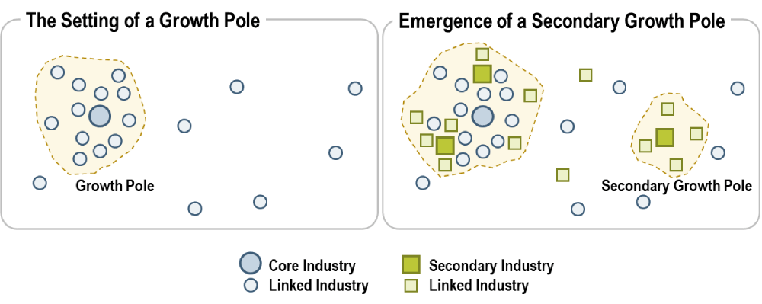
GROWTH POLE AND GROWTH CENTRE - MODELS

Slide 5
In transforming from a theoretical idea to a practical instrument and gaining public popularity, growth poles lost their original meaning and intellectual rigor. In the 1980s, most growth pole projects were abandoned for failing to achieve their initial goals, although some policy targets had unrealistic expectations.
Core industries can involve a wide variety of sectors such as automotive, aeronautical, agribusiness, electronics, steel, petrochemical, etc. Direct effects imply the core industry purchasing goods and services from its suppliers (upstream linked industries), or providing goods and services to its customers (downstream linked industries).

Slide 6
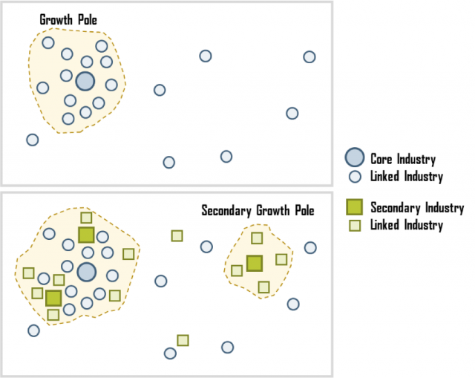

Slide 7
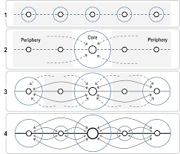
GROWTH POLE AND GROWTH CENTRE - MODELS

Slide 8
The central idea of the growth poles theory is that economic development, or growth, is not uniform over an entire region, but instead takes place around a specific pole (or cluster). This pole is often characterized by core (key) industries around which linked industries develop, mainly through direct and indirect effects.
Indirect effects can involve the demand for goods and services by people employed by the core and linked industries supporting the development and expansion of economic activities such as retail.
The expansion of the core industry implies the expansion of output, employment, related investments, as well as new technologies and new industrial sectors.

Slide 9
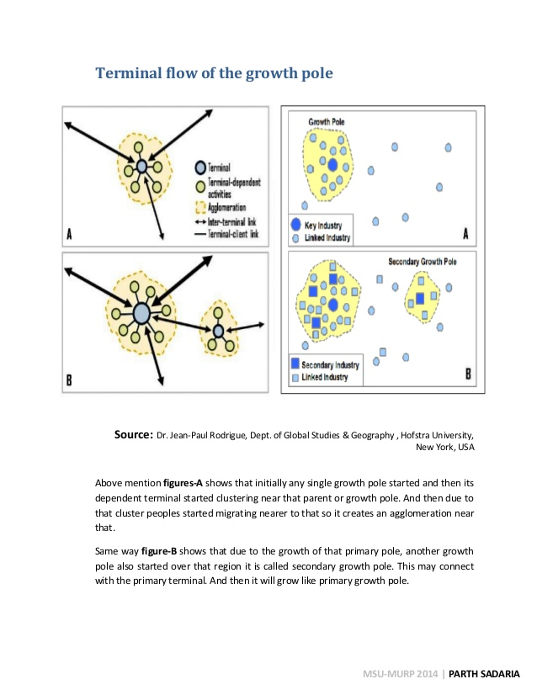

Slide 10
Global supply chains have challenged several dimensions of the growth poles theory since growth and linkages generated by a core industry could concern activities located elsewhere.
Generally such a growth steals the development of hinterland and leads to skewed pattern of development. Growth generally does not take place simultaneously at all places but is concentrated in few places. Such places are called growth poles and growth centres. The theory of growth pole and growth centres may be successfully applied to attain a balanced regional development.
Growth centres and growth poles theory is very attractive for a regional planner due to the concepts used in the theory.

Slide 11
Most important is the promise of trickle down in future. As according to this concept over a period of time, deglomeration economies start functioning on a pole when it grows excessively due to factors like
Congestion, traffic problems
ii. High population density
iii. High prices of land and inputs
iv. Limitation of the expansion of the market.
Hence, for a successful planning, it is necessary that the trickle down from the poles is facilitated and polarization is contained beyond a limit by way of suitable planning for the region.

Slide 12
The industries start moving towards hinterland. This aspect has led to most of the developing, underdeveloped as well as developed countries of the world to adopt this model for regional planning.
Therefore to attain a balanced regional development the theory of growth pole suggest that some places in the backward regions must be selected and developed as poles. This actually means creating structural economic disparities deliberately but this will be of worth as the development of growth poles in the backward region will have two effects

Slide 13
i. It will result in higher average income of the region.
ii. It will send impulses of economic and industrial pulses throughout region by trickledown effect.

Slide 14
Thank you

