Slide 1
INTERNAL PROCESSES

Slide 2
Internal Process
Internal process - a process that shapes the earth with forces from the interior of the earth. Internal processes are known as endogenetic process.
The three forces are compressional force, tensional force and shear/lateral force.

Slide 3
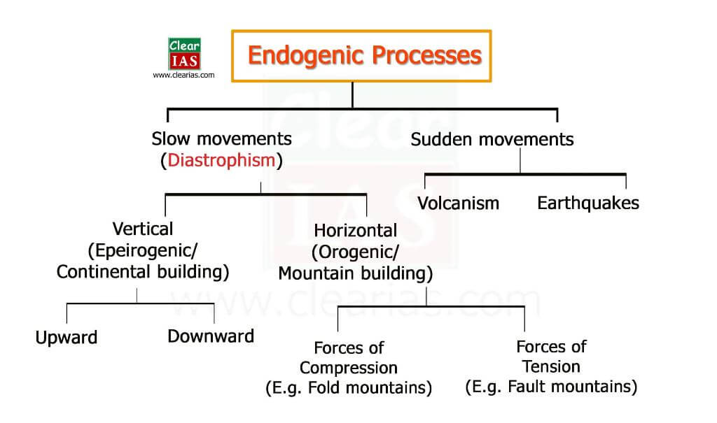

Slide 4
TYPES
1. Diastrophism
2. Volcanism

Slide 5
DIASTROPHISM
Diastrophism is the process of deformation of the Earth's crust which involves folding and faulting. Diastrophism can be considered part of geo tectonics. The word is derived from the Greek διαστροϕή diastrophḗ 'distortion, dislocation'.
Epirogeneic Movement
Orogenic Movement

Slide 9
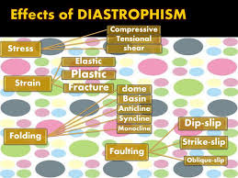

Slide 13
EPEIROGENIC MOVEMENTS

Slide 16
OROGENIC MOVEMENTS
In contrast to epeirogenic movement, the orogenic movement is a more complicated deformation of the Earth’s crust, associated with crustal thickening (due to the convergence of tectonic plates).
Such plate convergence forms orogenic belts that are characterised by “the folding and faulting of layers of rock, by the intrusion of magma, and by volcanism.
Orogenic or the mountain-forming movements act tangentially to the earth surface, as in plate tectonics.
Tension produces fissures (since this type of force acts away from a point in two directions), and compression produces folds (because this type of force acts towards a point from two or more directions).

Slide 18
