Slide 1
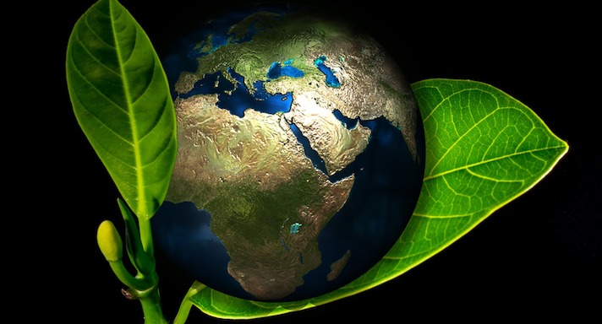
GOOG MORNING TO ALL MY DEAR WONDERFUL STUDENTS
HAVE A HAPPY MORNING
BIO-GEOGRAPHY: BASIC ECOLOGICAL PRINCIPLES
DAY ORDER:VI
08/08/2020 9.30-10.30AM
S.SASIKALA
GUEST LECTURER IN GEOGRAPHY.
GCW(A)K

Slide 2
Ecology is the study of how organisms interact with one another and with their physical environment. The distribution and abundance of organisms on Earth is shaped by both biotic, living-organism-related, and abiotic, nonliving or physical, factors.

Slide 8
Importance of Ecology
The following reasons explain the importance of ecology:
Conservation of Environment
Ecology helps us to understand how our actions affect the environment. It shows the individuals the extent of damage we cause to the environment.
Lack of understanding of ecology has led to the degradation of land and the environment. It has also led to the extinction and endangerment of certain species. For eg., dinosaurs, white shark, mammoths, etc. Thus, the study of the environment and organisms helps us to protect them from any damage and danger.
Resource Allocation
With the knowledge of ecology, we are able to know which resources are necessary for the survival of different organisms. Lack of ecological knowledge has led to scarcity and deprivation of these resources, leading to competition.

Slide 9
Energy Conservation
All organisms require energy for their growth and development. Lack of ecological understanding leads to the over-exploitation of energy resources such as light, nutrition, and radiation, leading to its depletion.
Proper knowledge of ecological requirements prevents the unnecessary wastage of energy resources, thereby, conserving energy for future purposes.
Eco-Friendliness
Ecology encourages harmonious living within the species and the adoption of a lifestyle that protects the ecology of life.

Slide 10
The SEVEN ecological principles are
1) Maintain diversity and redundancy,
2) Manage connectivity,
3) Manage slow variables and feedbacks
4) Foster complex adaptive systems thinking,
5) Encourage learning,
6) Broaden participation, and
7) Promote polycentric governance systems.

Slide 11
SAVE OUR EARTH SAVE OUR ECOSYSTEM
THANKS TO ALL

